Slide 1
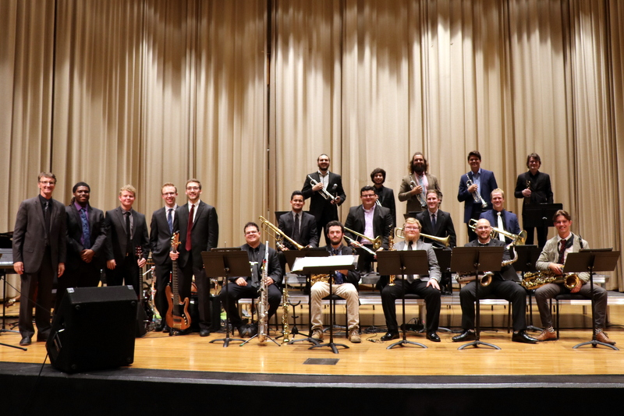
Making it groove
Coaching the Drummer and Lead Players in the Jazz Ensemble
Dr. Brian Mueller, Lecturer in Percussion and Jazz Studies, MTSU
https://www.brianmuellermusic.com/
Jamey Simmons, Director of Jazz Studies, MTSU
www.jameysimmons.com

Slide 2
With some guided listening and simple coaching and rehearsal techniques you can help your students improve their performance in the jazz style and make your big band sound better. We’ll take some time to “dive in” to recordings and also demonstrate these in a live setting.

Slide 3
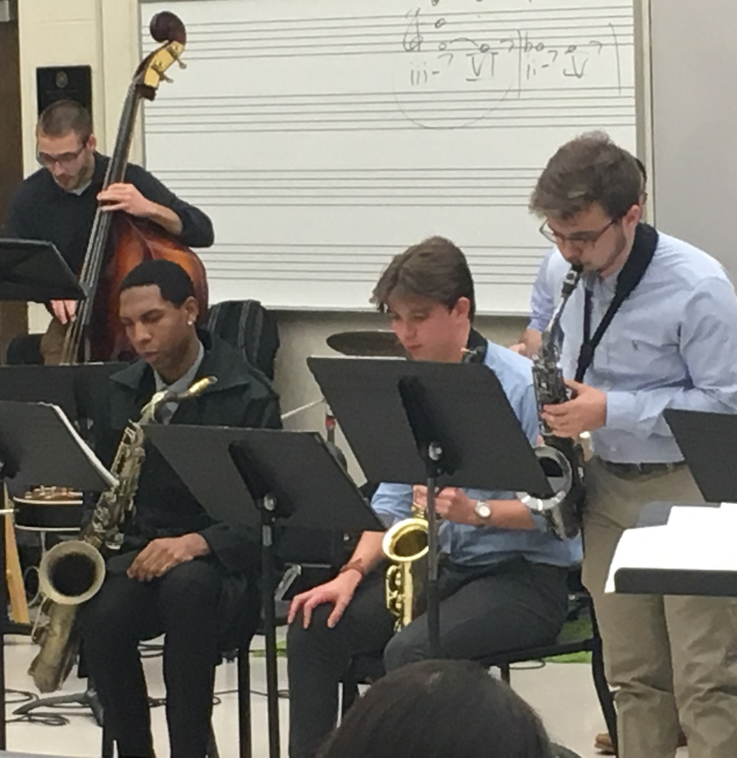
Guided Listening
Balance
Roles within the band
Style/Jazz Conception

Slide 4
Tune #1 “Hay Burner” from Basie Straight Ahead
Recorded 1968, L.A.
All Sammy Nestico charts
https://www.youtube.com/watch?v=OlBQIb-sODA

Slide 5
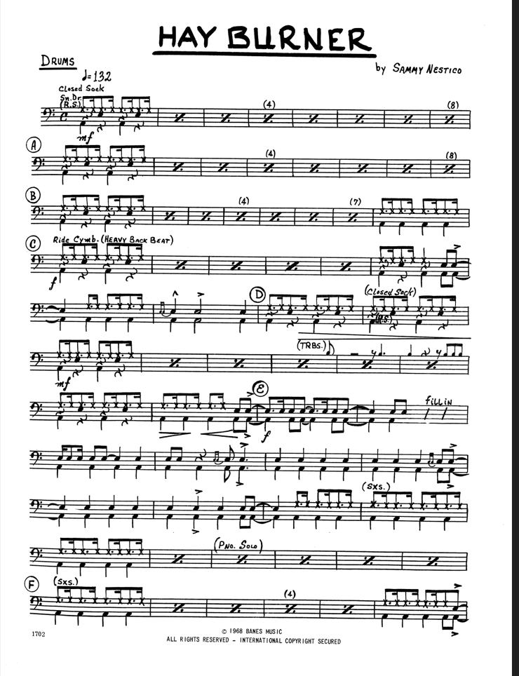

Slide 6
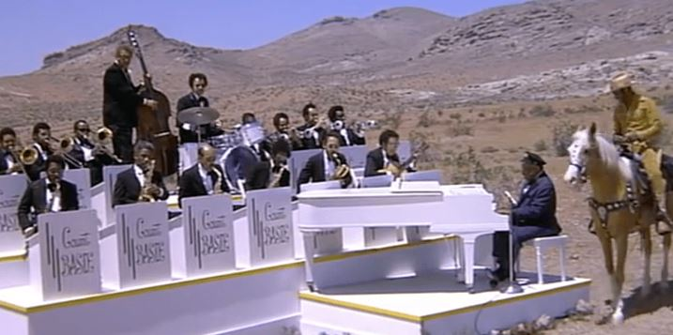
Drummer’s Perspective
Brian Mueller
Resources can be found at:
https://brianmuellermusic.com/clinic-handouts.html
Locking in the Quarter Note between the ride and bass is paramount
Locking in really just means “consistency”
Build confidence in your quarter note! Sing the pulse while practicing.
The ‘skip beat’ (‘ands’) are de-emphasized in the ride part
Know the Chart, not the Part
The notated groove is not always the correct groove – check out recordings to clarify the groove and style.
There are often important figures not reflected in the drum part – write them in! Be able to sing them!
Play clear set-ups that match the intensity of the figure they precede.

Slide 8
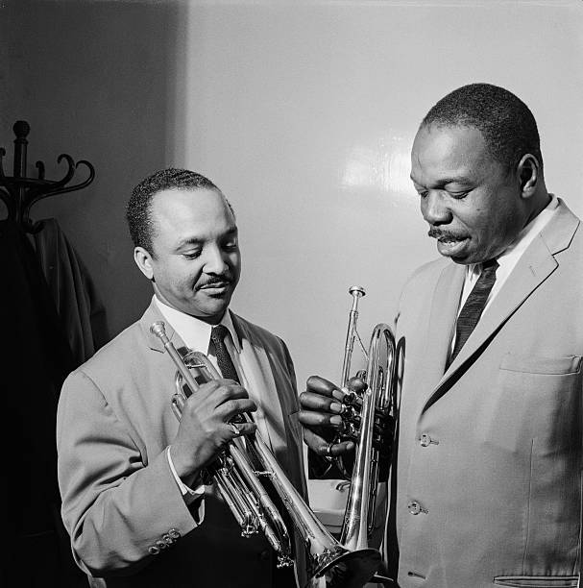
Trumpeter’s Perspective
Jamey Simmons
Subdivision is the key! DO BAH DO BAH DO
The “DAHT” concept and the Louis Armstrong articulation
Listening to drummer is paramount
Ride and hat
Lead players should be able to sing drum fills
Big 2s and 4s – WAIT = WEIGHT
Trumpet section and rhythm section set-up must allow lead player to hear drums
Give long notes personality
Strive for contour in phrases that the rest of the horns can follow

Slide 9
Tune #2 “MAGIC FLEA” from Basie Straight Ahead
Recorded 1968, L.A.
All Sammy Nestico charts
https://www.youtube.com/watch?v=ywZgCAhDtys

Slide 10
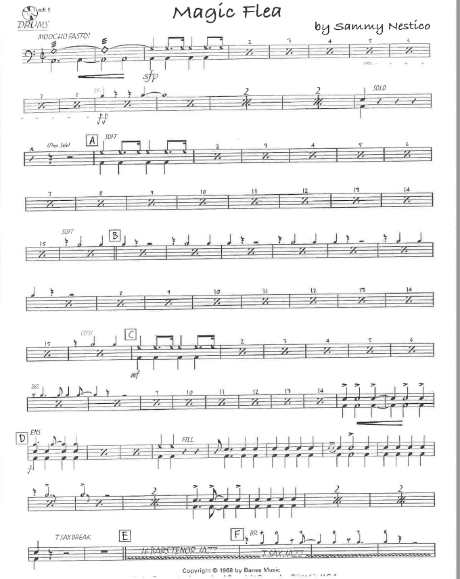
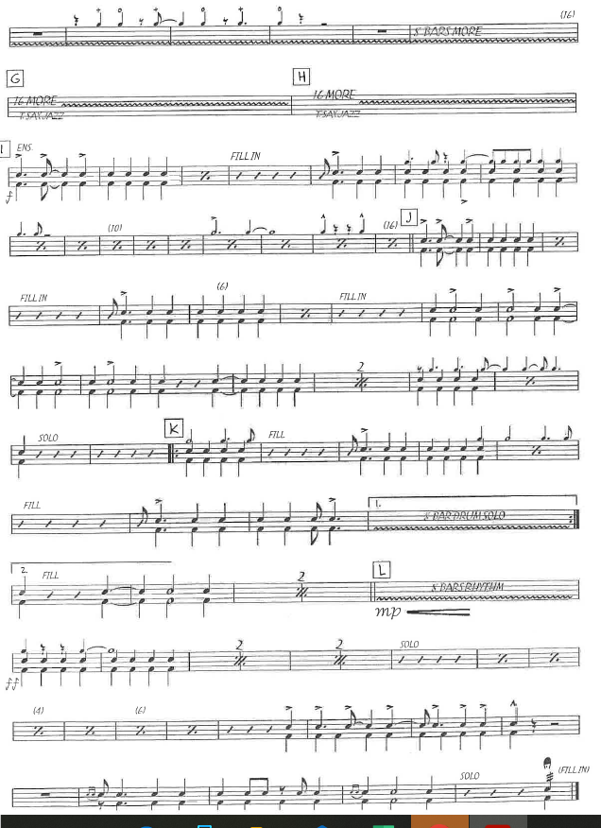
Add drum part for Magic Flea here

Slide 11
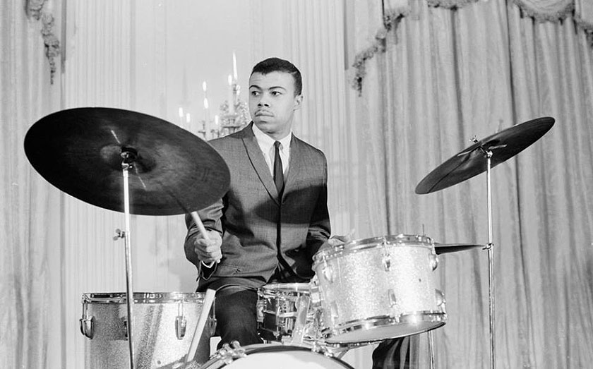
Drummer’s Perspective
Brian Mueller
Most obvious challenge: the tempo!
Build endurance: sustain basic ride pattern for 5-10 minutes at a time, working toward 300+ BPM (or try multiple reps of a shorter time span).
Comping will be simpler at faster tempos – work on controlling quarter notes, off beats, simple combinations.
Avoid the “disappearing ride cymbal” sound – even here, the quarter note should be consistent, but the time will be straightened out and dynamically more even.
Stay calm, BREATHE, and feel a SLOWER PULSE – half notes, whole notes.
Be able to SING the horn figures at tempo – get your EARS up to tempo before trying to get your HANDS up to tempo.
For the solos: Elaborate a simple, singable idea. Notice that even though the drum solos have a “lot of notes,” you can easily hear / sing the main idea / accents.

Slide 12
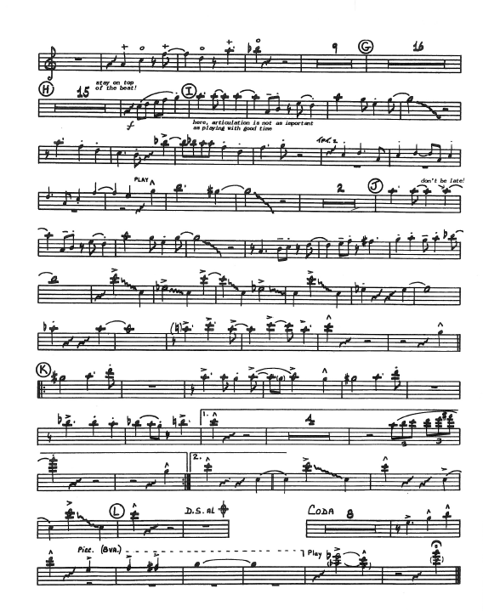

Slide 13
Trumpeter’s Perspective
Subdivision is the key! Fast swing or bop subdivision = DIDDLE IDDLE IDDLE IDDLE
Think in 2 to help relax mind, lines are legato, sometimes completely slurred
Brighter tone, think of crispness
Short DAHT or DIT
Strive for contour in phrases that the horns can follow
Listening to drummer is paramount
Ride and hat
Lead players should be able to sing drum fills

Slide 14
Tune #3 “Blue Carnaval” by Jamey Simmons
Medium Fast Samba
https://www.jameysimmons.com/store/blue-carnaval

Slide 16
Drummer’s Perspective
Brian Mueller
Understand that the basic groove (bossa nova) is a STYLE, not a PATTERN.
Work on independence between the hands and feet (playing the ”samba feet” pattern), and freedom with the cross-stick / snare drum pattern.
Be able to get in and out of the groove after fills / figures.
Be careful with balance here – the bass drum should be slightly under the ride cymbal, and the cross-stick / snare drum should be slightly above the ride dynamically.
Make sure the bass drum locks in and blends well with the bass. Make sure the bass itself is also balancing well with the ensemble.

Slide 17
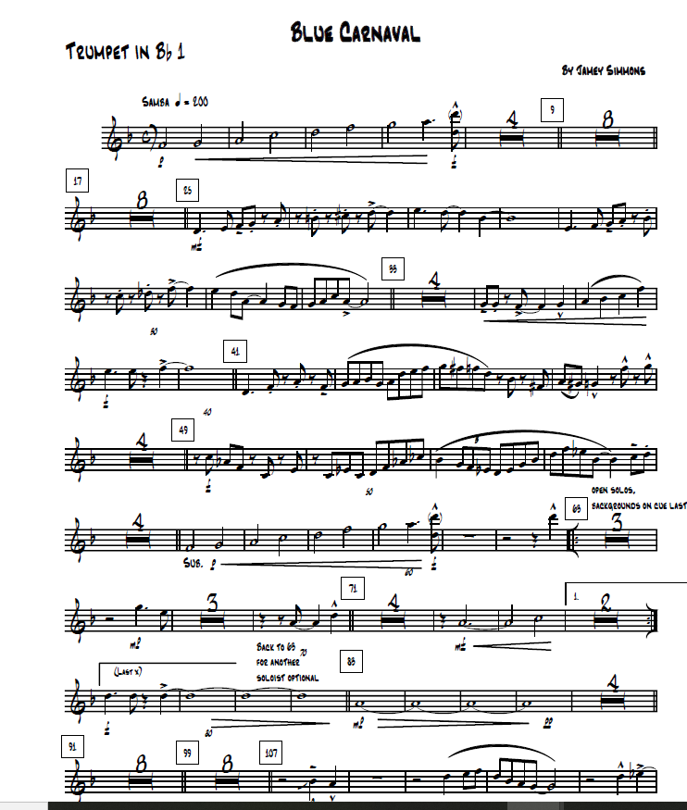
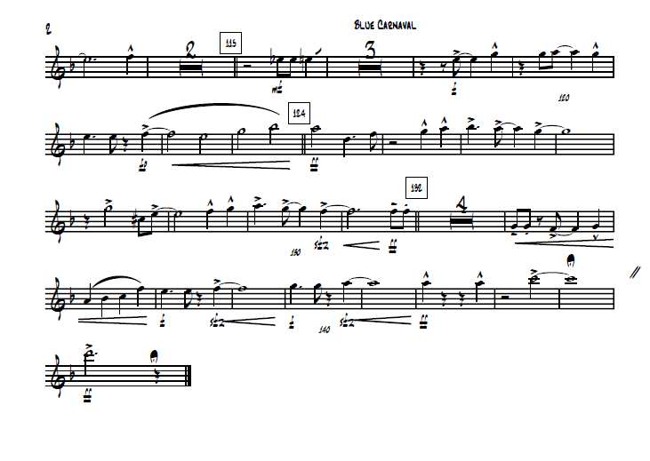

Slide 18
Trumpeter’s Perspective
Jamey Simmons
Subdivision = think “shaker”!
Most Brazilian music is light in nature – avoid the temptation to make short notes heavy. The groove and articulation makes the energy – not loudness!
Know the difference between your role as lead player and as a part of a unison
In fast latin styles horn players tend to rush “big 2s” and “big 4s”
Have lead players use a routine that encourages filling out sound in all registers, especially low and high registers
Again – think drum fills for short offbeat phrase endings

Slide 19
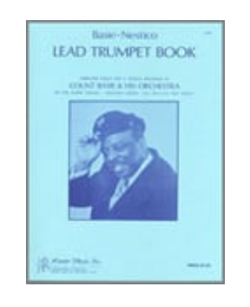
Resources:
https://www.jwpepper.com/Basie-Nestico-Lead-Trumpet-Book/5942511.item#.Y8DXUXbMJEZ
Basie-Nestico Lead Trumpet Book – Sonny Cohn, lead trumpeter

Slide 20
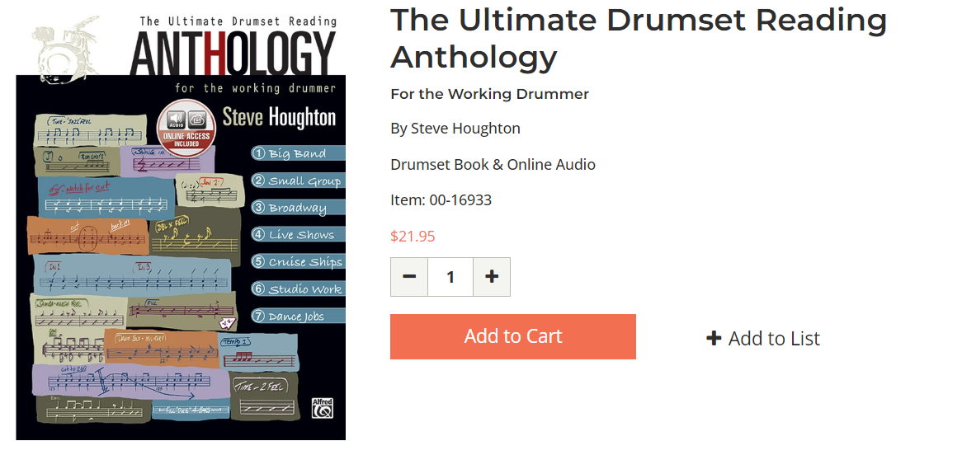
Resources:
https://www.alfred.com/the-ultimate-drumset-reading-anthology/p/00-16933/
Steve Houghton:

Slide 21
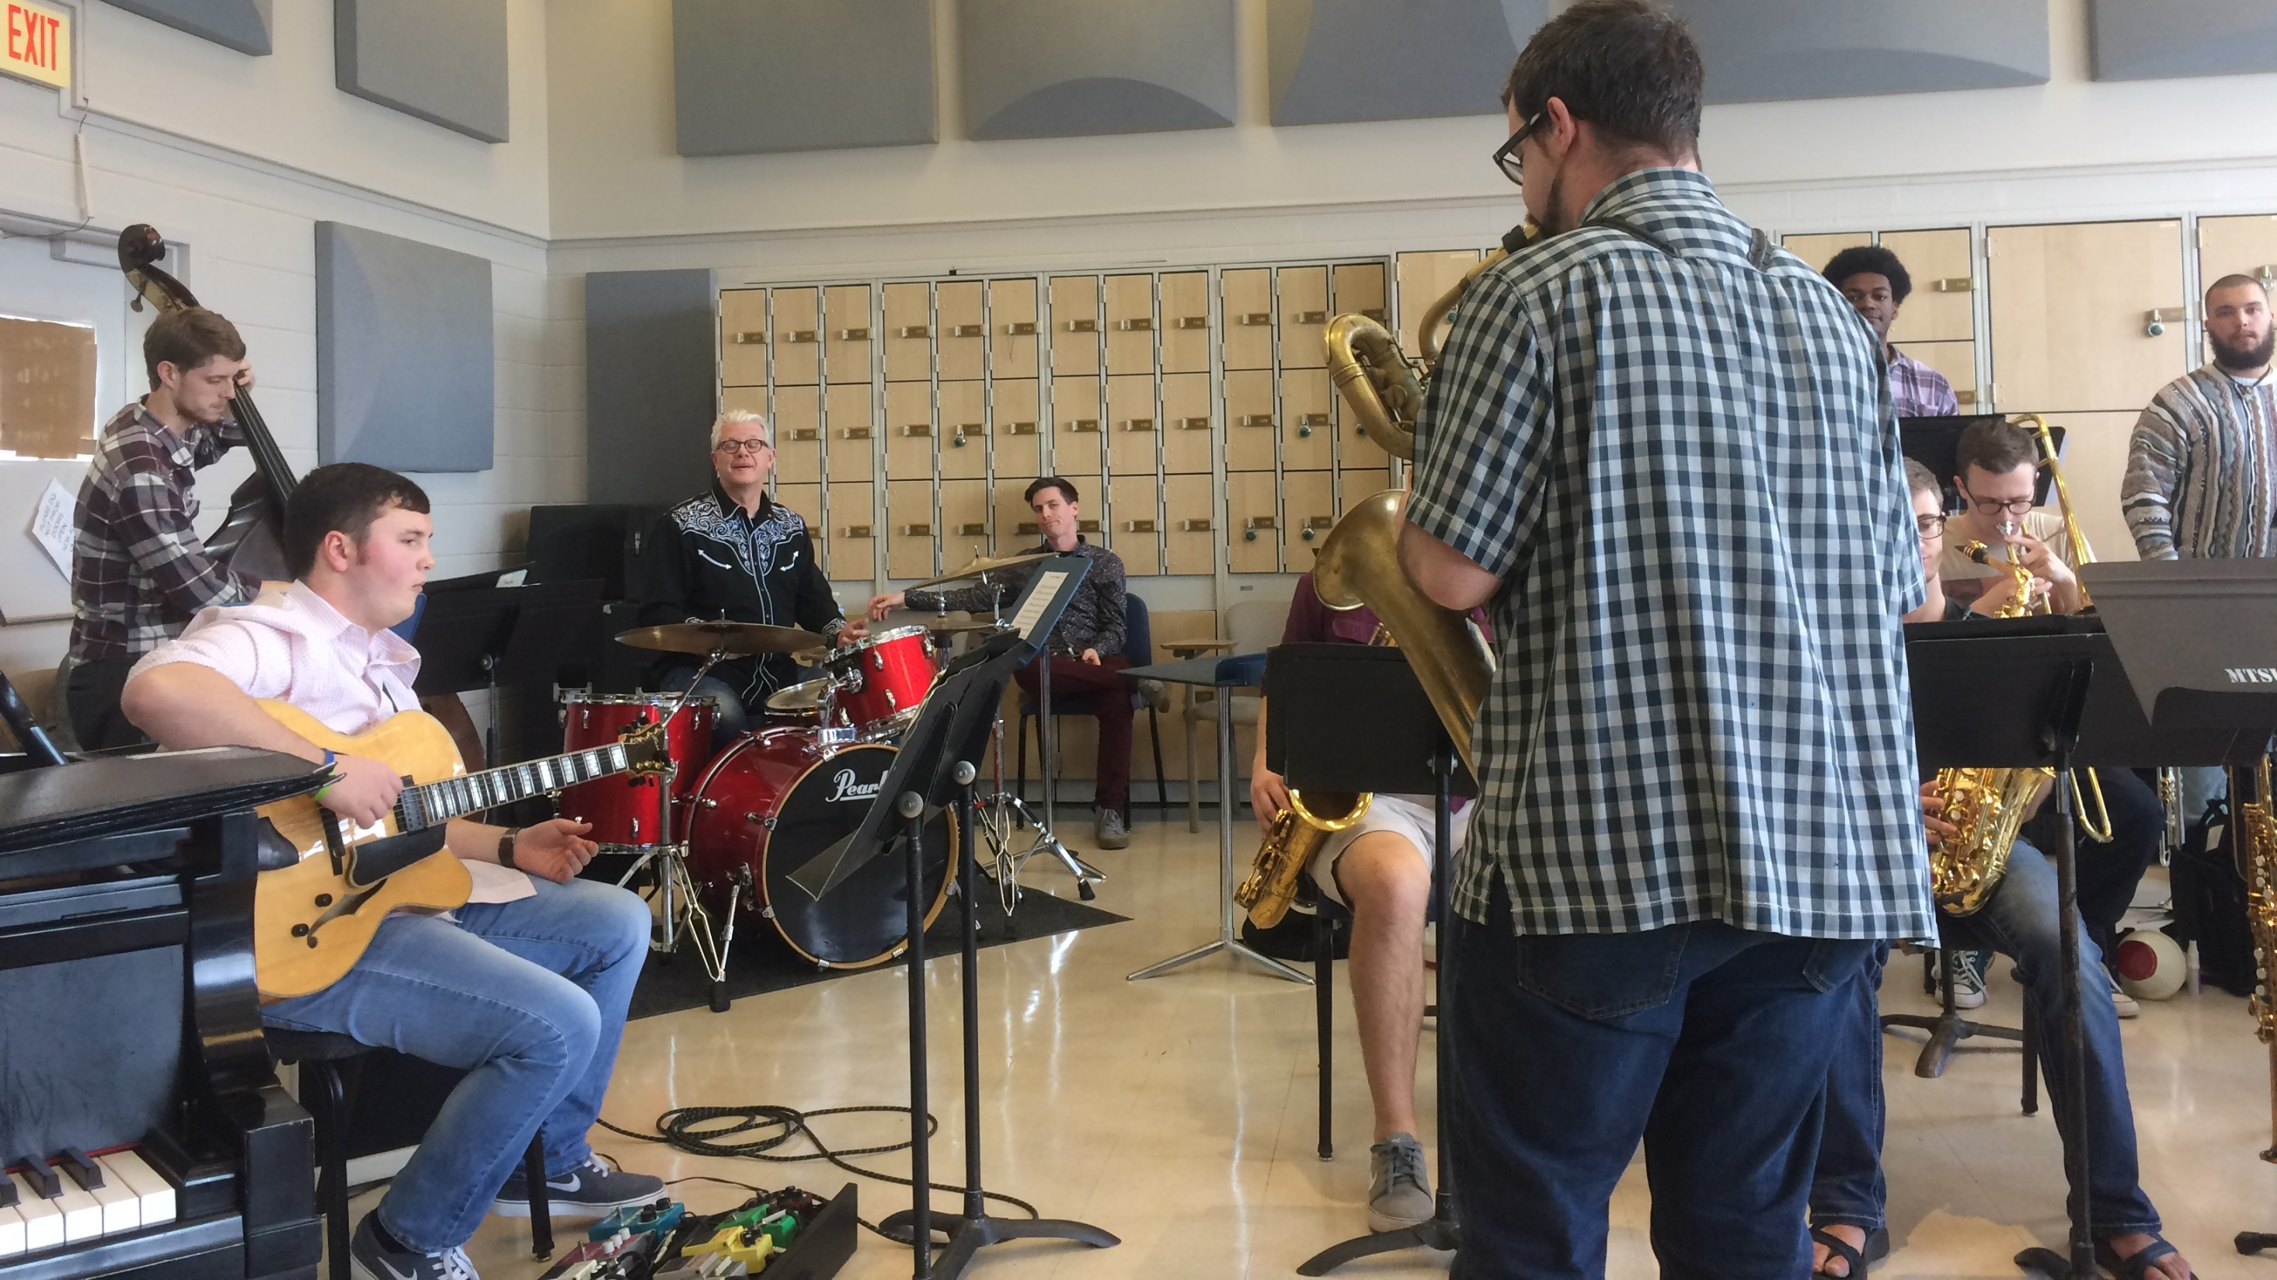
Try a rehearsal with section leaders and rhythm section.

Slide 22
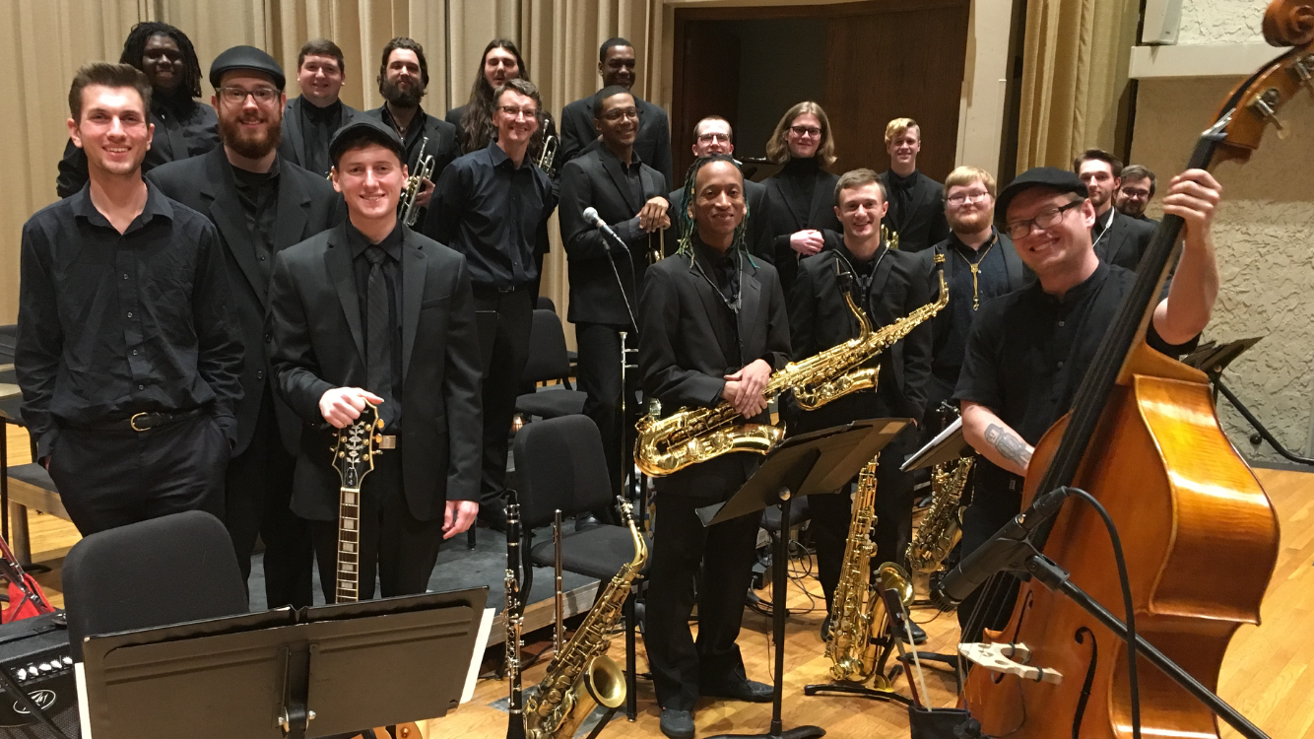
Summary
Encourage your students to get out and hear live big band music
MTSU Jazz Ensemble 1 3/16/23, 7:30 p.m., Hinton Hall
MTSU Jazz Ensemble 2 3/20/23, 7:30 p.m., Hinton Hall
MTSU Illinois Jacquet Jazz Festival, ALL DAY April 1st, 7:30 p.m.
Hear the Establishment Big Band, Nashville Jazz Orchestra, Ryan Middagh Jazz Orchestra, and others around the area.

Slide 23
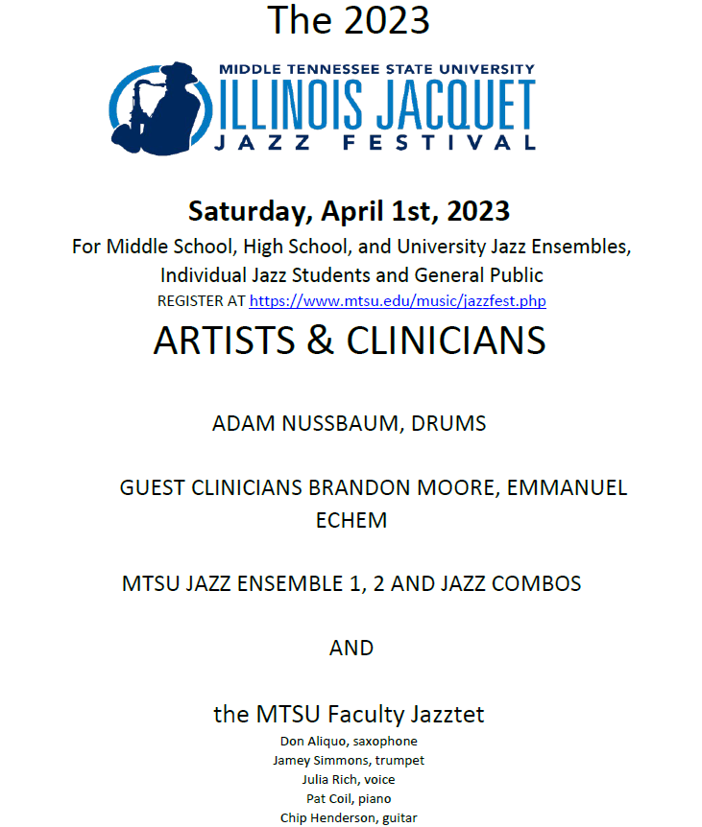
Ensemble and Individual Student Registration at
https://www.mtsu.edu/music/jazzfest.php

Slide 24
Adam Nussbaum, Guest Clinician/Headliner
Performed and recorded with Michael Brecker, James Moody, Kenny Wheeler, Gil Evans, Stan Getz, among others
http://adamnussbaum.net/

Slide 25
Thank you very much for coming! Please feel free to contact us with any questions.
Jamey Simmons
James.Simmons@mtsu.edu
615 898 2724
Brian Mueller
Brian.Mueller@mtsu.edu

