Slide 1
Taking the Time
Teaching Improvisation to the Jazz Ensemble
Jamey Simmons, Director of Jazz Studies, Middle Tennessee State University
www.jameysimmons.com

Slide 2
Challenges teaching improvisation in a large ensemble setting:
Size of ensemble
Disparity of ability level
Disparity of theory knowledge
Repertoire geared toward written arrangements and compositions

Slide 3
Improvisation is left to the individual soloist - demanding confidence in theory concepts, a strong sense of style and a dedication to listening to live and recorded jazz.

Slide 4
With some simple coaching techniques you can help your students improve on their road of improvising and help raise the level of improvisation within the ensemble. To help your improvisers, use simple and quick strategies to help with both individual soloists and the whole group. I’ll take some time to demonstrate and actually experiment as a group.

Slide 5
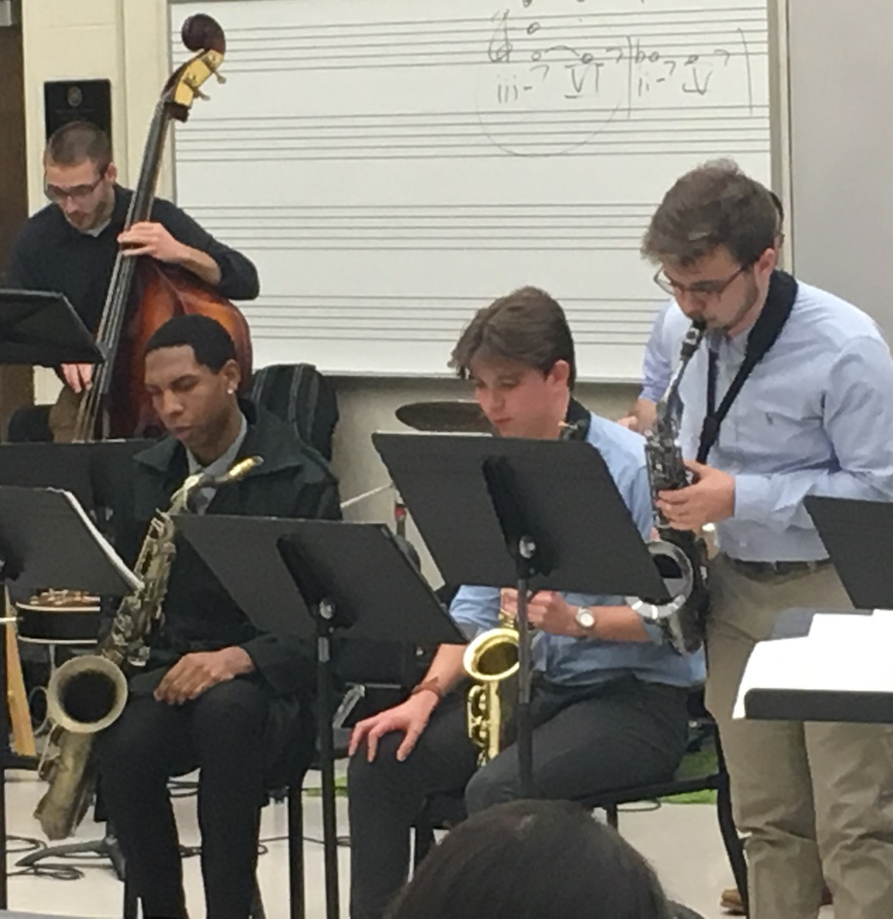
PART 1
Coaching the Individual Soloist – How?
Session with rhythm section
Coaching with ensemble looking on
Private lesson

Slide 6
Emphasis #1 - The Melodic Approach
Students may never play the entire melody in a jazz ensemble performance – melody is the starting point for improvisation!
Provide a simple lead sheet with chord changes for the soloist
Whole band sings w/ recording

Slide 7
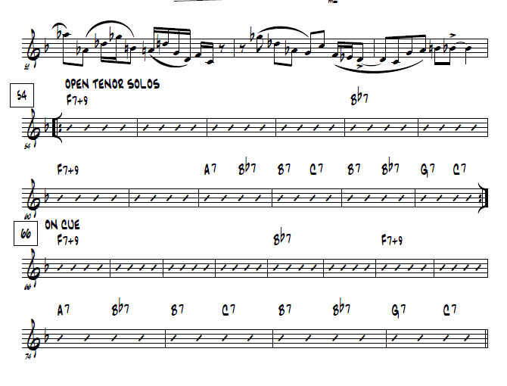

Slide 8
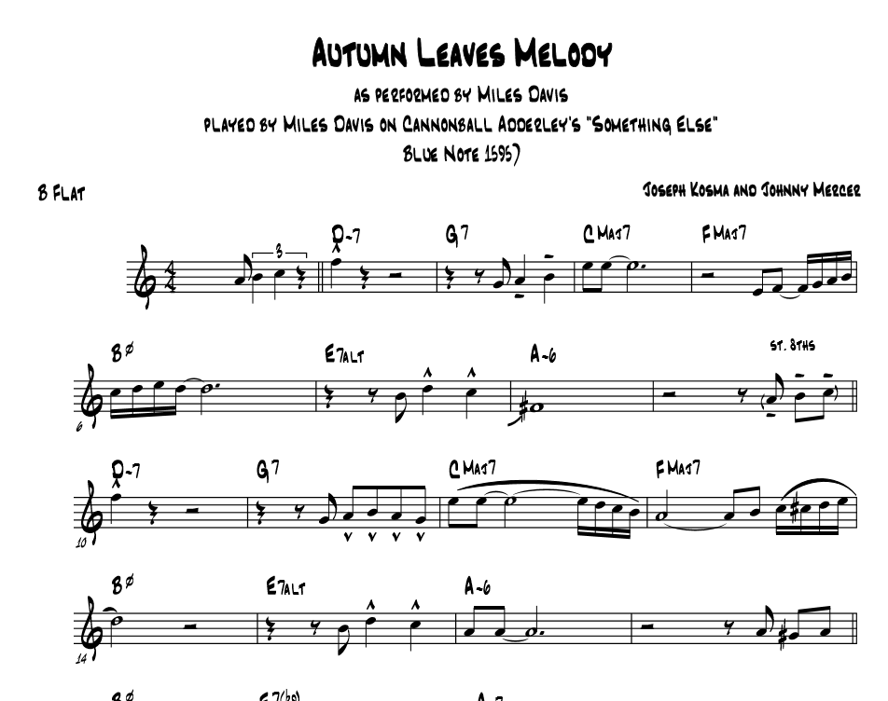
Use guided listening!

Slide 9
Emphasis #2 - Melodic Variation Techniques
Syncopation (pushes, delays)
Jazz effects
Enclosures and non-harmonic tones
Paraphrase (shorten long notes)
Augment (lengthen short notes)
Connecting lines
Ornaments

Slide 10
Emphasis #3 Harmonic Solo Strategies (from The Jazz Theory Book, by Mark Levine, and How to Improvise, by Hal Crook)

Slide 11
Repetition of phrases
Repetition of rhythms and hemiola
Laying back on time feel
Sequencing phrases
Going higher in tessitura
Holding long notes
Using the play/rest approach
Tense harmonies resolving to stable harmonies (V – I)
Manipulating note density (8ths and 16ths) to less dense (quarters, halfs, whole) and vice versa
Moving from short phrases (one measure long) to medium (2 – 3 measures) to long phrases (4 – 8 measures)

Slide 12
- Utilize Easy Jazz Language (may be used in group context!)
Digital patterns
Roots (memorize)
12
123
1235
87
875
8765

Slide 13
Guide tones
Have students build a guide tone map
Find where 7s move to 3rds of next chord
Very easy to teach to the whole ensemble on simple blues forms
Students should start understanding basic ii – V – I “licks”. See my website for a good beginning list. https://www.jameysimmons.com/educationblog

Slide 14
This is an example of a guide tone “map”

Slide 15
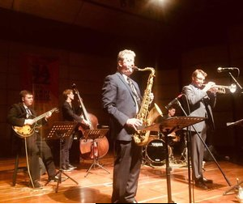
PART 2
Group Improvisation Techniques

Slide 16
Technique #1 - Scale, arpeggio, and theory drills
Quick warm-ups that build skills over weeks, semesters, and years.
Please see https://www.jameysimmons.com/educationblog for a downloadable set of drills, score and parts, for jazz ensemble.

Slide 17
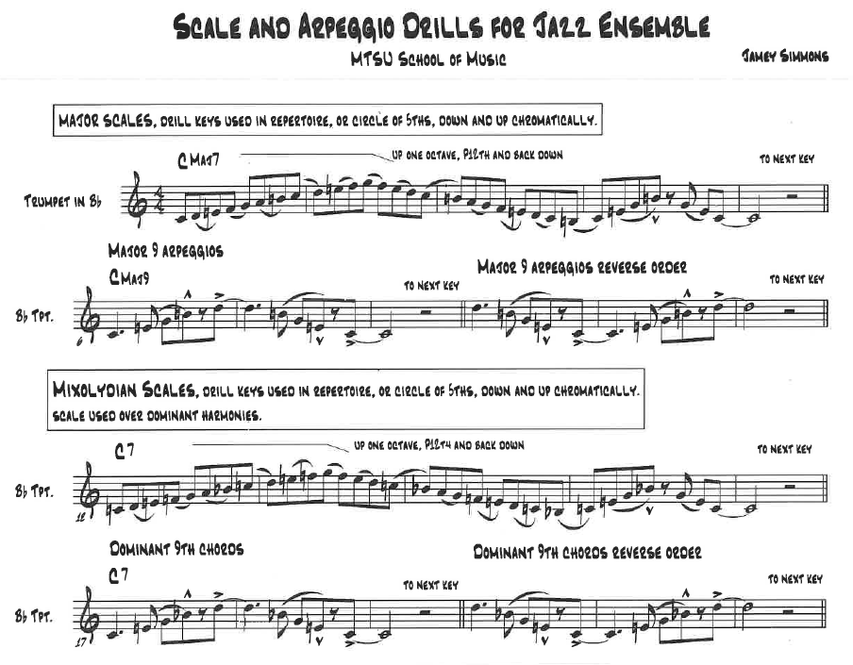

Slide 18
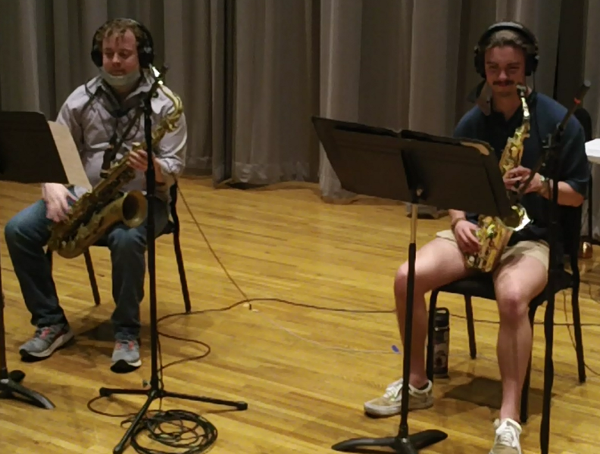
Drummer plays fills and kicks the rhythms
Pianist can play chords in LH with scales in RH, or vice versa

Slide 19
Go through multiple key centers, using the circle of 5ths (counter-clockwise), with varied amounts of rest between each key center.
Focus on keys/harmonies used in your repertoire, rote tune learning
Try random key centers (see the root matrix, provided)

Slide 20
Technique #2 - Y’all Play
Everyone improvises at once with a specific goal in mind. Walk around the room, assessing and offering suggestions.

Slide 21
Goals may be:
Students should derive an original melody with a groove in the drums, or rhythm section vamp. Those comfortable enough to share should share with the ensemble.
Students become comfortable with scales, arpeggios, rhythms, progressions, melodies.
Students can rehearse with each other.
“Loop” a chord sequence, parts of improvisational form to “jam” on.
Let students go long enough to meet goals, short enough to keep rehearsal flow going. Think :30 to 1 ½ minutes.

Slide 22
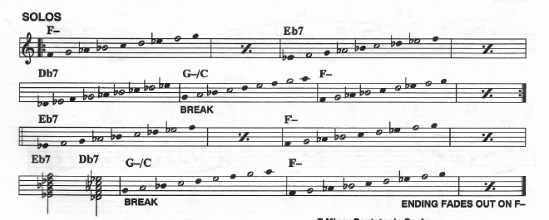
Harmonies to “Song for My Father” by Horace Silver

Slide 23
It will sound like a mess! Embrace it!

Slide 24
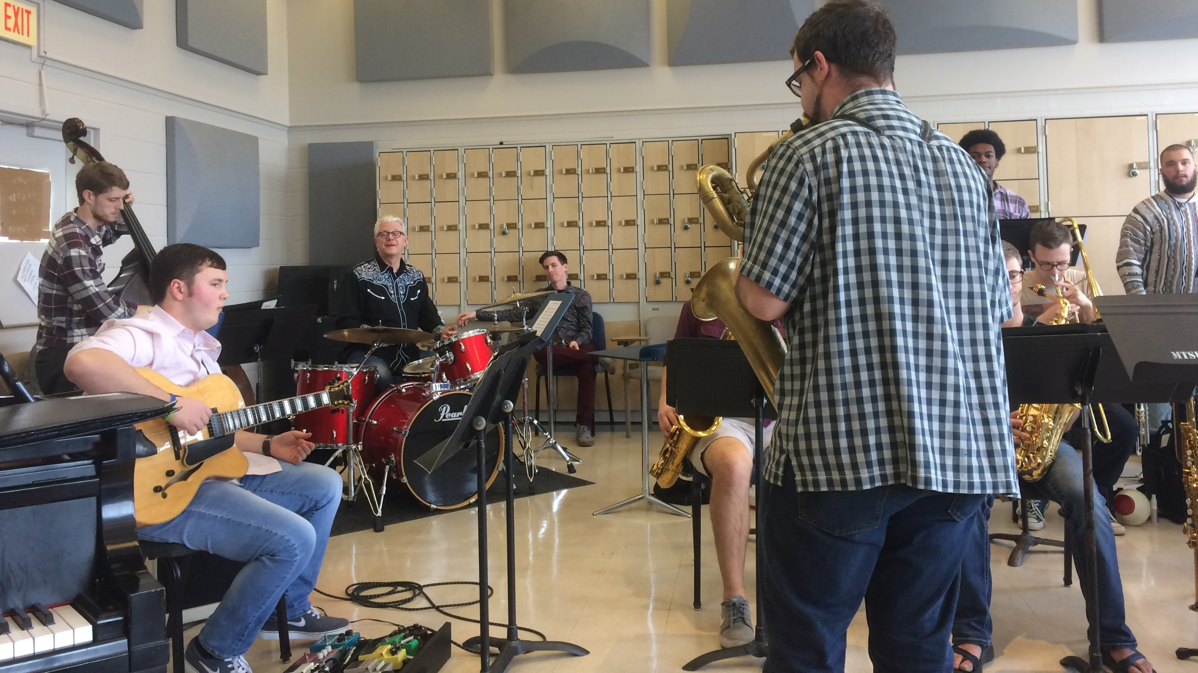
Technique #3
Call and Response
- the purest form of jazz education.

Slide 25
There are infinite methods of using call and response. The following are the ones that I use the most:

Slide 26
Catch my pitch – the ensemble plays pitches back to the instructor, students self-diagnose
- start simple, slow
- pick up pace
- can be used as long tones for winds

Slide 27
Catch my rhythm – call and response of rhythms, articulations, and jazz effects using one pitch. For a suggested rhythm sheet, see https://www.jameysimmons.com/educationblog

Slide 28
Catch the melody – the ensemble plays back melodies starting on small scale fragments or intervals and moves to full melodies. Try incorporating melodic or harmonic material from a chart the band is working up.

Slide 29
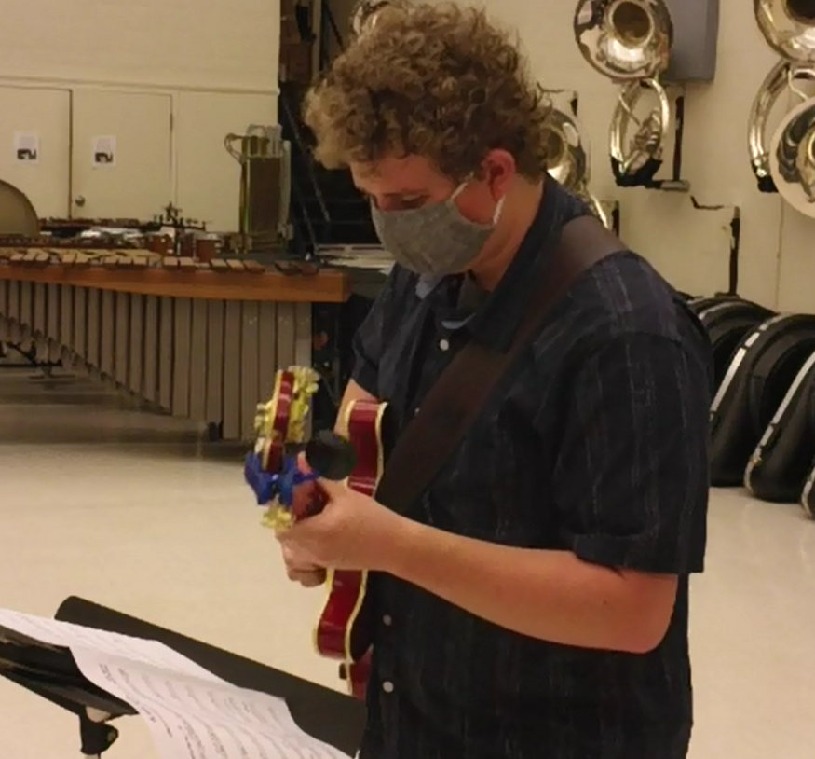
Rote tune learning – the ensemble learns a full jazz tune, melody, roots, harmonies all by ear. Start with simple tunes from the Real Easy Book vol. 1, published by Sher Music.

Slide 30
Teach an introduction and ending, add simple backgrounds and add solos for a complete performance on your next concert.

Slide 31
Group transcription – doing a “group transcription” right in jazz rehearsals takes the fear factor out of the process. Students that are comfortable with the process can help the newbies! Find recordings that are simple enough, and are musically rewarding, and are in comfortable ranges. The following are excellent solos:
So What and Freddie Freddie Freeloader, Miles Davis solo
Song for My Father, Horace Silver solo

Slide 32
Technique #4 - Blues Form Drills
These drills help students start applying theory and rhythmic knowledge to the blues form in real time.

Slide 33
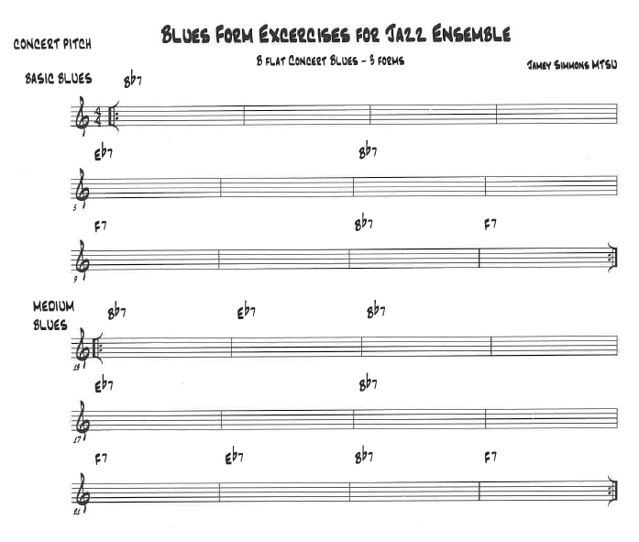
In my set of drills I use:
3 different B flat blues forms (easy to difficult)
Scales from our regular scale drill
a variety of scale/arpeggio types
Use of the bebop scale (a scale with both 7s!)

Slide 34
The goals:
Mastering rhythms and scalar ideas
Utilizing different dominant scales (mixolydian, Lydian dominant, bebop) ascending and descending starting from different scale degrees.
Perform arpeggios in inversions
Learn the art of sequencing
Mix ideas with existing knowledge and EXPERIMENTATION!

Slide 35
I encourage you to try several of these in rehearsals to challenge your improvisers and pulling in new young artists to the creative world. Remember:
Don’t do on a grand scale, 3, 4, 5 minutes every now and then can work wonders.
You may think you don’t know much about this – but students don’t know that!
Find one or two things to be prepared with to challenge students with each semester.
Listen to, talk about, sing, and clap a lot. Keep things simple.
You don’t need to know theory to improvise, you can learn theory through improvising.
ANYONE CAN IMPROVISE – Jamey Aebersold

Slide 36
Thank you WSMA, and good luck teaching the next generation of jazz artists!
Questions about any of this:
Jamey Simmons
Middle Tennessee State University
James.Simmons@mtsu.edu
615 898 2724
www.jameysimmons.com
Free pedagogic resources at https://www.jameysimmons.com/educationblog

